Slide 1
OOSE UNIT-1

Slide 2
1.
Introduction to software engineering

Slide 3
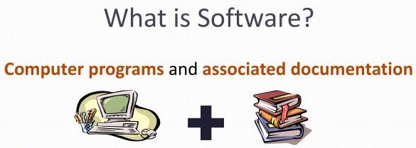

Slide 4
What is Software engineering?
Software Engineering is the technological and managerial discipline that is concerned with all aspects of software production

Slide 5
The evolving role of software

Slide 6
Software as a dual role
As a PRODUCT
delivers the computing potential
Information transformer
- producing,
- managing and
- displaying
information
As the vehicle for delivering the product
acts as the basis for the control of the computer
The communication of information(networks)
The creation of other programs

Slide 7
Characteristics of Software
developed or engineered
01
but it is not manufactured
does not wear out
but it deteriorates due to change.
Software
Characteristics
02
Software
Characteristics
Software
Characteristics
03
custom built
rather than assembling existing components.

Slide 8
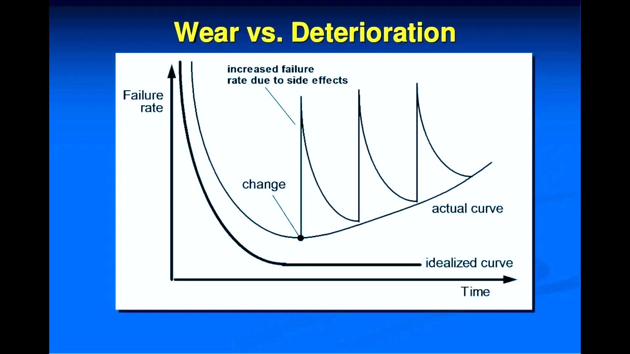

Slide 9
Software Applications
directly interacts with computer hardware
System software
Embedded software
controls various functions.
01
05
designed to solve user problems
set of a software product that shares common features
Application software
02
Categories of software
06
Product-line software
deals with specific application
application that is accessed via web browsers over a network
Engineering software
03
07
Web-applications
Software
software used for scientific purposes
solve complex problems
Scientific software
04
08
Artificial intelligence software

Slide 10

Software Myths
Myths are created when there is no meaningful or logical information is available or the people do not have correct knowledge about the software or software development.

Slide 11
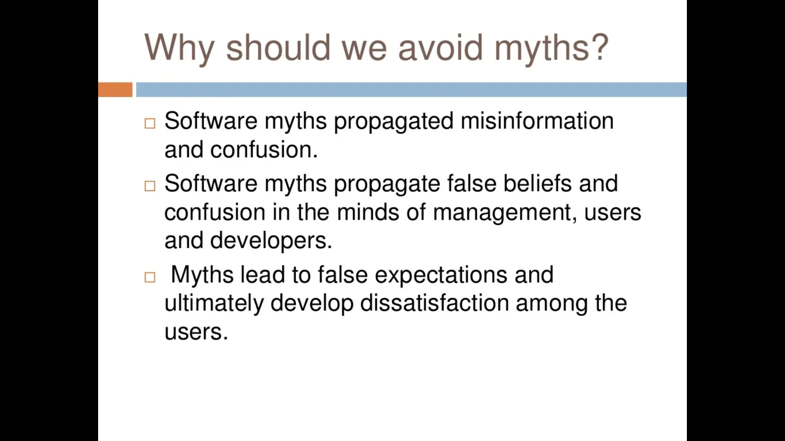

Slide 12
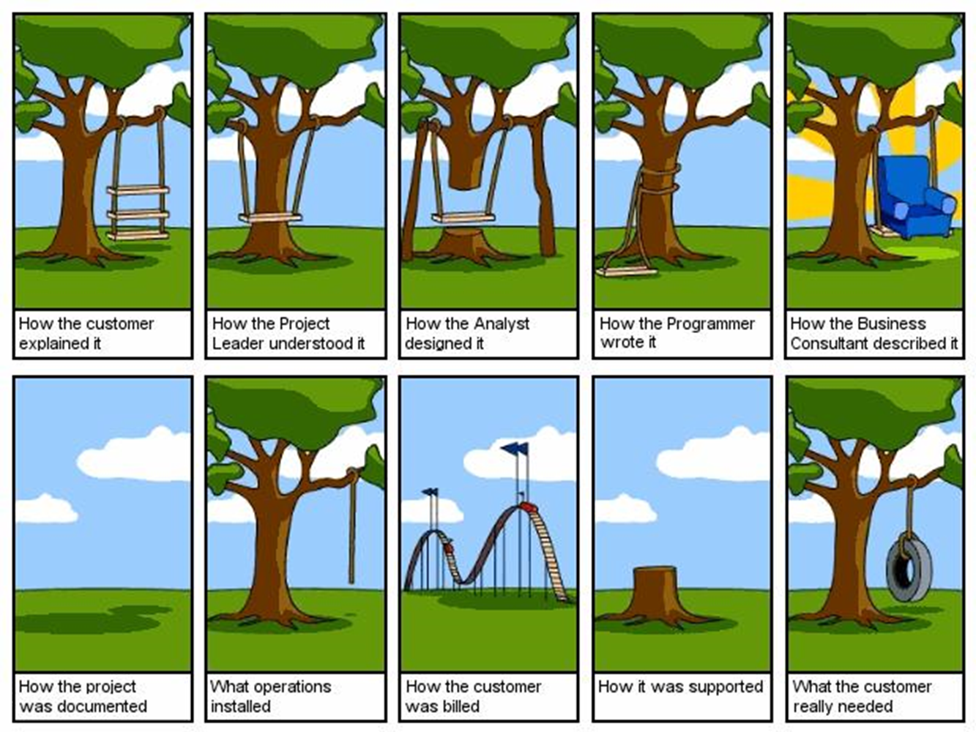

Slide 13
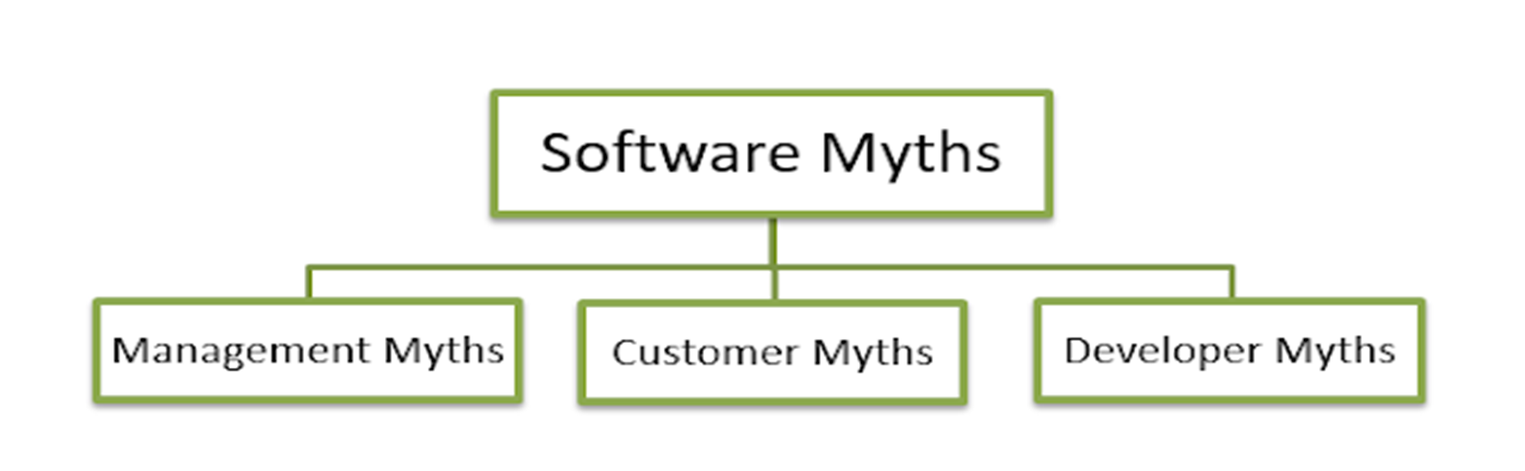
There are three types of software myths that are given as follows:

Slide 14
MANAGEMENT MYTHS | MYTHS | REALITY
 | Books full of standards and procedures are enough | Books may exist but Are they used? Software practitioners are aware? Reflect modern software engineering practice? Is it complete? Focus on quality?
 | Newest computers are needed | CASE(Computer Aided Software Engineering) tools are more needed than latest hardware for software development
 | Add more programmers if it is behind schedule and catch up | Adding people to a late software project makes it later
 | Outsource the software project to a third party and relax | Outsourcing the software project requires more monitoring and control

Slide 15
CUSTOMER MYTHS | MYTHS | REALITY
 | A general objective statement is enough | Poor definition of objectives causes failures. So a formal description of domain is essential
 | Changes in the software are easily accommodated since software is flexible. | Impact of change varies with the time

Slide 16
DEVELOPERS MYTHS | MYTHS | REALITY
 | Once we write the program, our job is done | Sooner you begin writing code, longer it takes to finish
 | Until I get the program running, I have no way of assessing the quality | Software quality assurance mechanisms should be applied at the inception of the project itself like formal technical review
 | The only deliverable work product for a successful project is the working program | Working program is only the software configuration. So documentation is also more important for the successful software project
 | Software engineering will make unnecessary documentation that will slow down the process | Software engineering is not about only creating documents but also about software quality

Slide 17
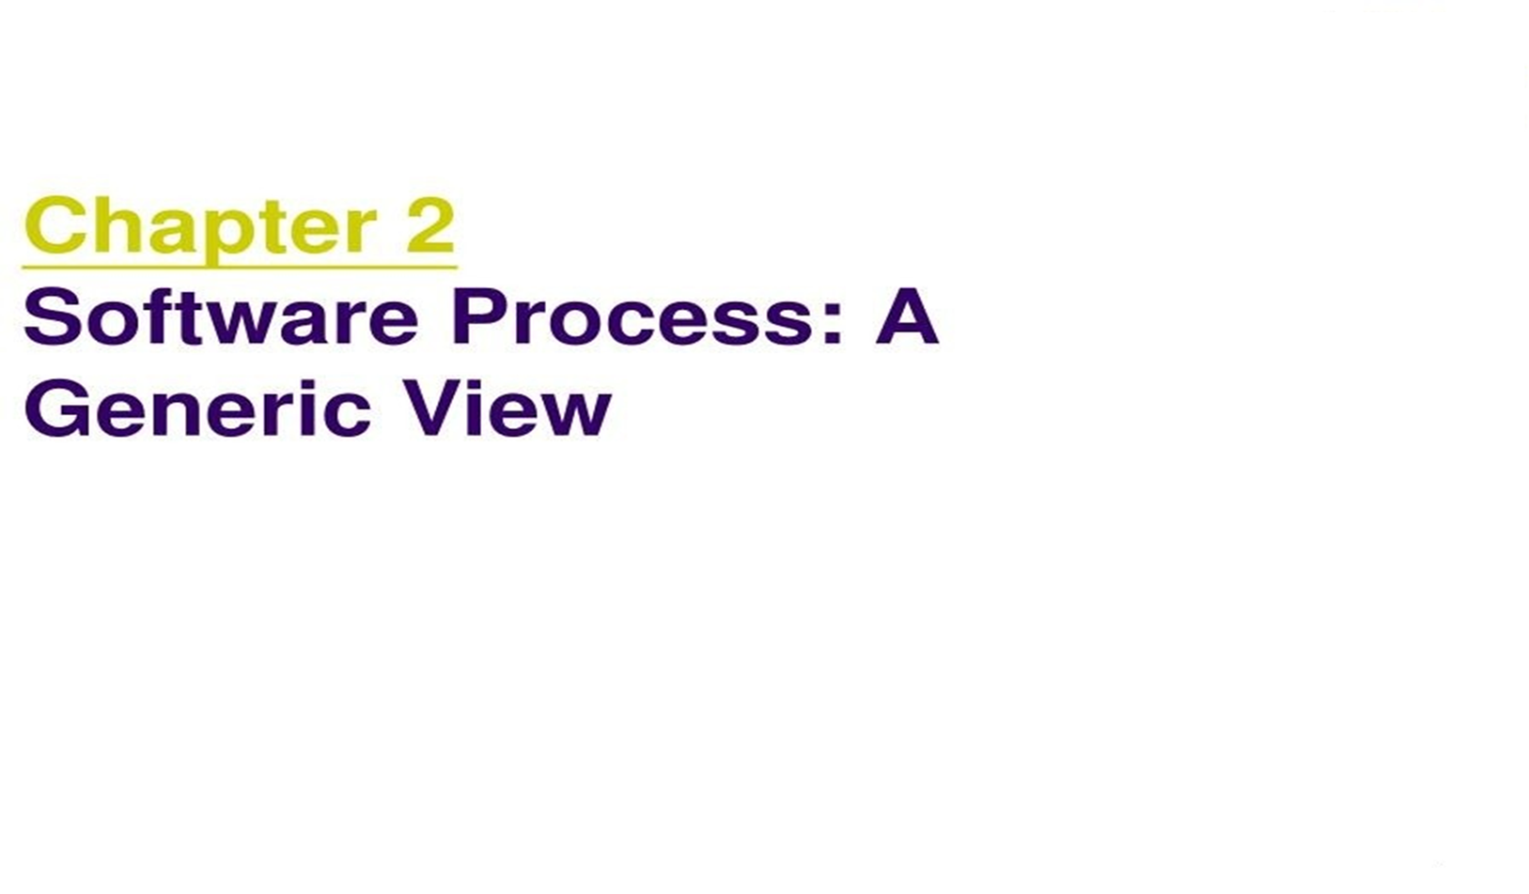

Slide 18
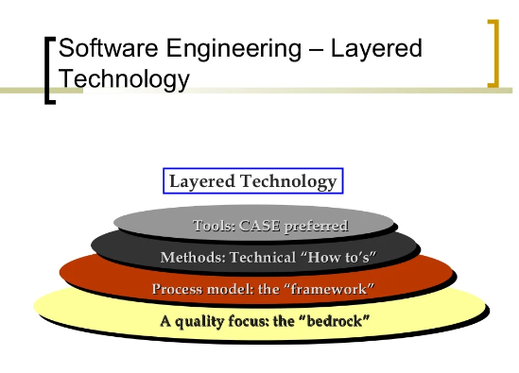

Slide 19
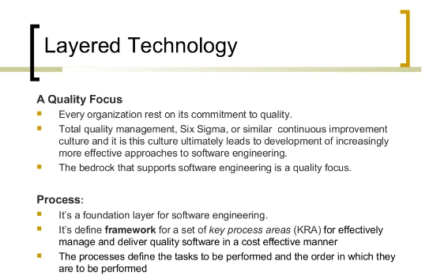

Slide 20
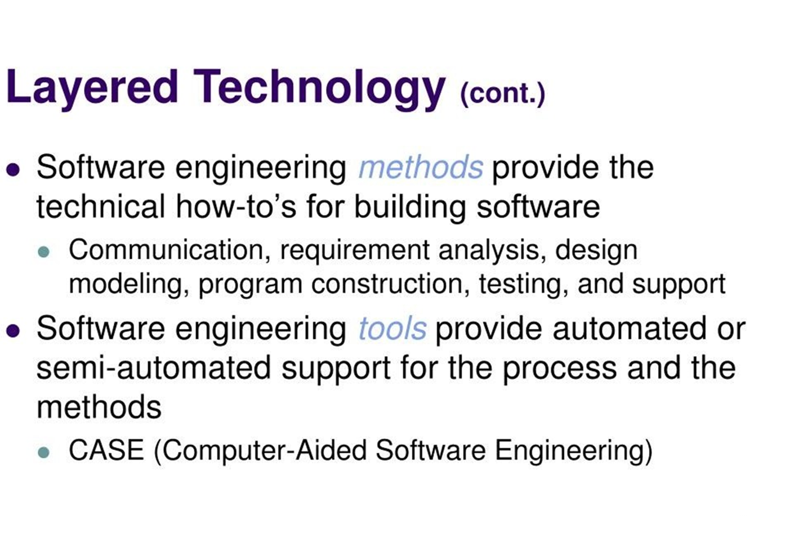

Slide 21
A GENERIC PROCESS MODEL
The generic process model is an abstraction of the software development process. It is used in most software since it provides a base for them.

Slide 22
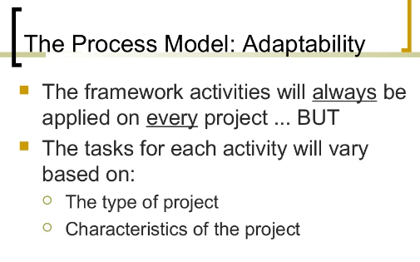

Slide 23
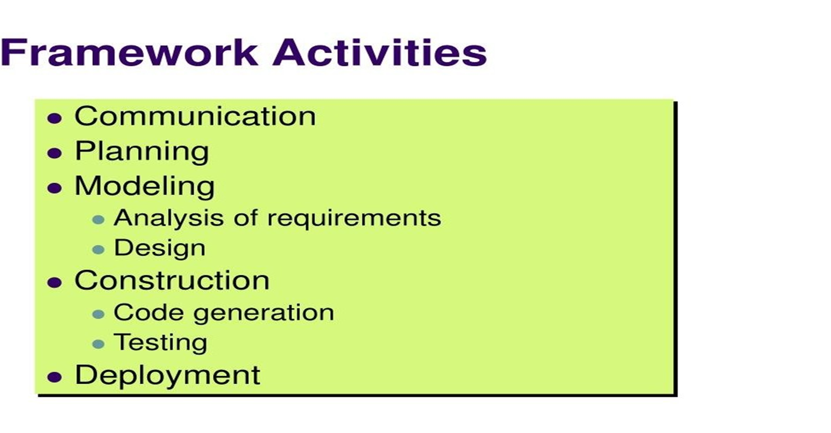

Slide 24
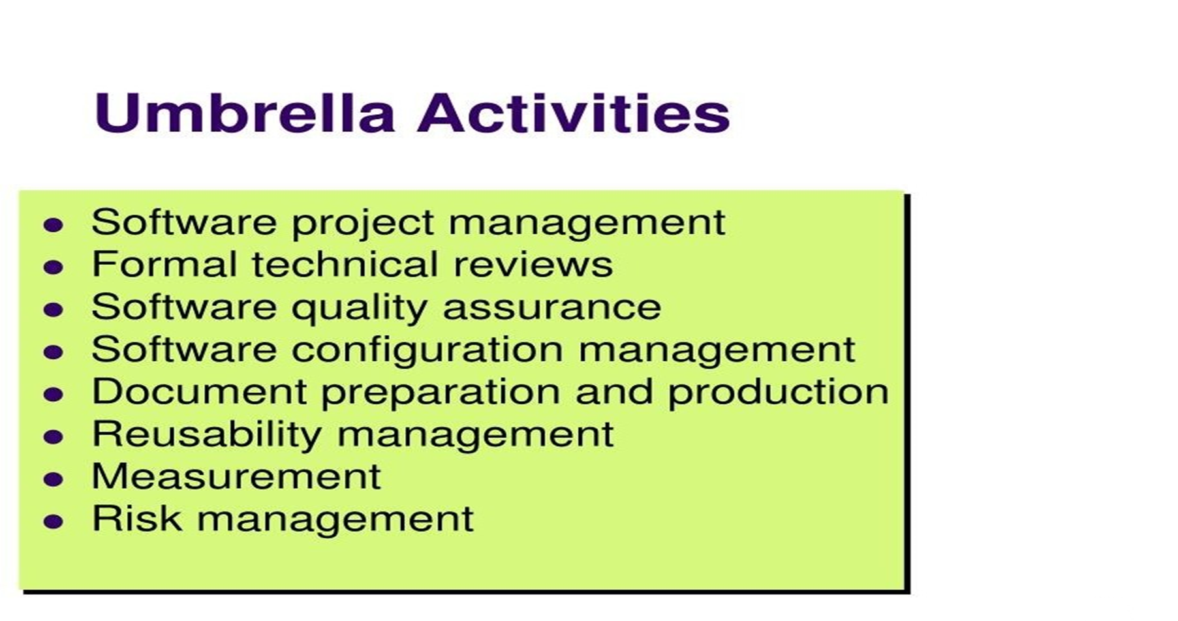

Slide 25
Capability Maturity Model Integration (CMMI)

Slide 26
WHAT IS THE CMMI?
Concept:
The application of process management and quality improvement concepts to software development and maintenance
Model:
A model for organizational improvement
Guidelines:
A guide for evolving toward a culture of engineering excellence.
Basis for Measurement:
The underlying structure for reliable and consistent software process assessments, software capability evaluations, and interim profiles

Slide 27
OBJECTIVES OF CMMI
The CMMI is an application of Total Quality Management principles to software engineering.
Emphasis should be on customer satisfaction.
The result should be higher quality software products produced by more competitive companies.

Slide 28
CMMI FIVE LEVELS
Process Maturity
High
Continuously
Improving
Process
5. Optimization
Focus on process
improvement
Initial
Unpredictable and
Poorly controlled
Process Capability
4.Quantitatively
Managed
Process measured
and controlled
Predictable
Process
Initial
Unpredictable and
Poorly controlled
Process Performance
Managing Change
Low
Standard,
Consistent
Process
3. Defined
Process characterized,
fairly well understood
Initial
Unpredictable and
Poorly controlled
Product and Process Quality
2. Managed
Can repeat previously
Mastered tasks
Disciplined
Process
Initial
Unpredictable and
Poorly controlled
Integrated Engineering Process
1. Initial
Unpredictable and
Poorly controlled
Initial
Unpredictable and
Poorly controlled
Project Management

Slide 29
CHAPTER-3
SOFTWARE PROCESS MODELS/SDLC

Slide 30
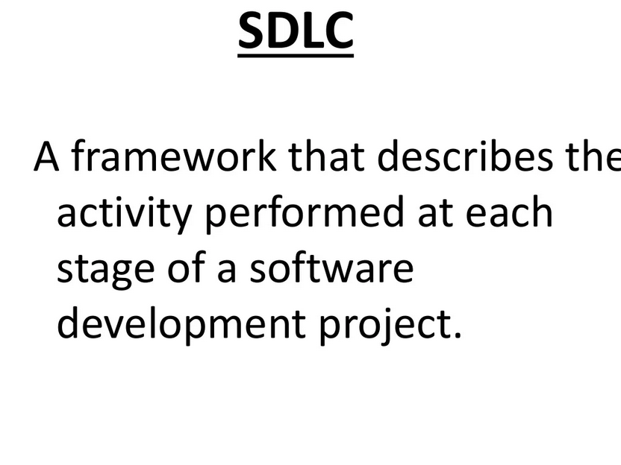

Slide 31
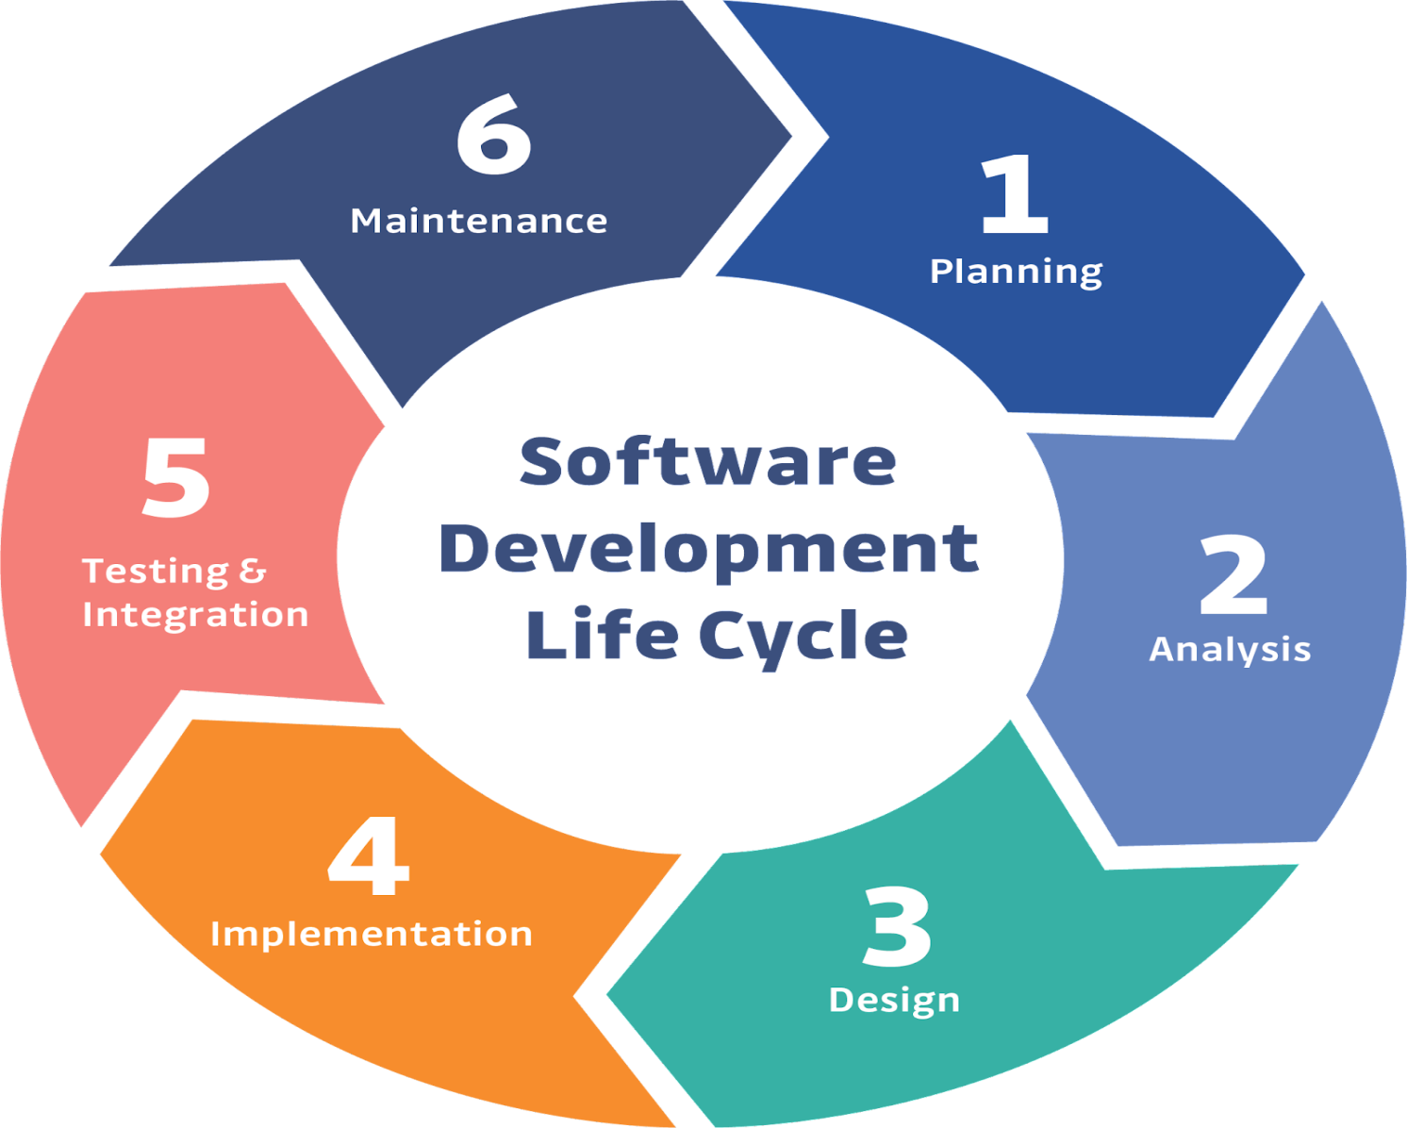
Steps in SDLC:
Planning/requirementsgathering
Analysis
Design
Implementation
Testing & Integration
Maintenance

Slide 32
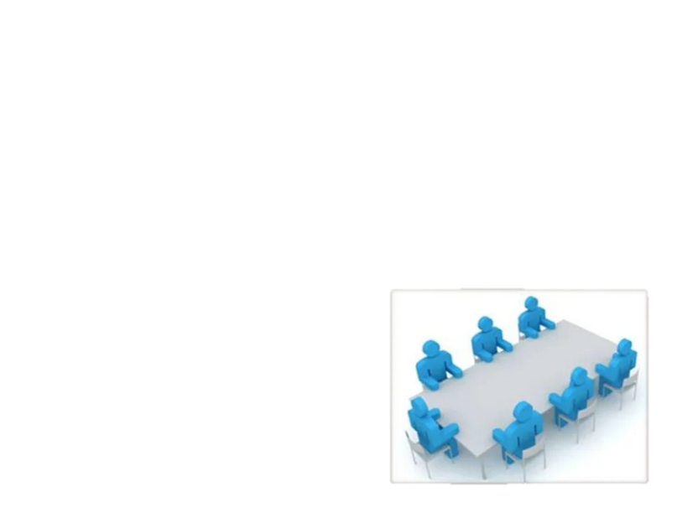
REQUIREMENTS GATHERING
Requirements gathering is the first stage of any SDLC model. This phase is basically a brainstorming phase because it has many sub stages to check how much idea can put into action for development.
Example: Customer interview

Slide 33
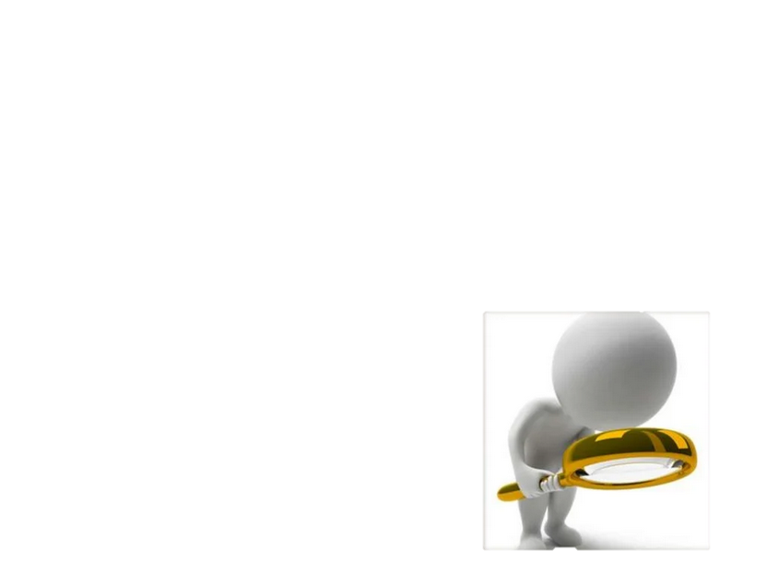
Analysis
At this stage the system is divided into smaller parts to make it easier more manageable for the developers, designers, testers, project managers and other professionals who are going to work on the software for latter stages

Slide 34

Design:
In this phase the design of the system to develop is made. The design is developed by the analysts and designers. The system analysts design the logical design of the project and then the designer makes the complete design of the project both front end as well as back end.
Example: understandable interface
user friendly/easy to use

Slide 35

Implementation:
It is the most technical and coding part of software development process. In this phase technical people are using their brains for coding in order to get the final successful result of the software product. A team of programmers are allocated by the company to work on the software

Slide 36
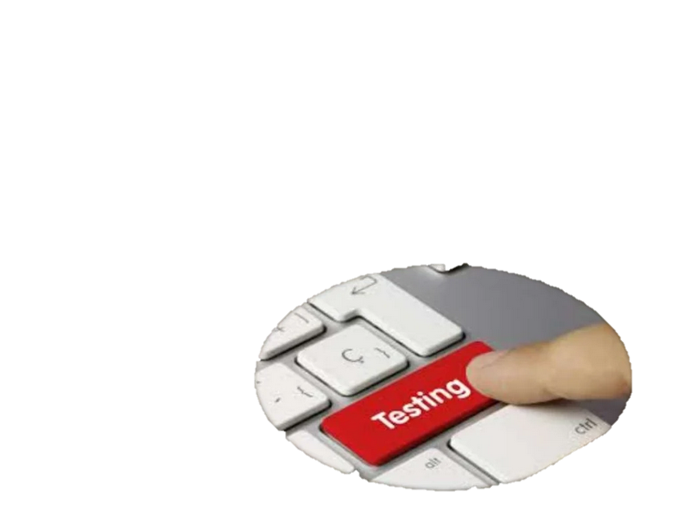
Testing:
After implementation phase, the testing phase starts where a group of technical and quality analysts people are working on the software. When the software is ready it is sent to testing department where quality analysts tests it thoroughly for different errors by performing various test cases

Slide 37
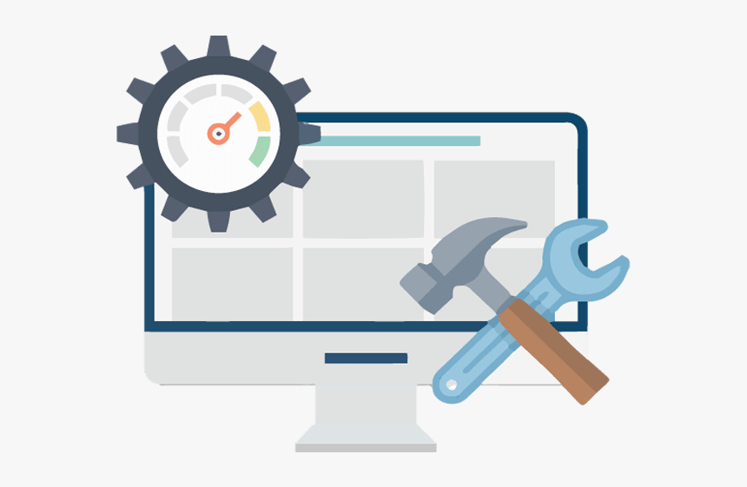
Maintenance:
Software maintenance is the final stage of SDLC process and is the process of enhancing and optimizing deployed software as well as remedying defects

Slide 38
Software Process Models
A software process model represents the order in which the activities of software development will be undertaken. It describes the sequence in which the phases of the software lifecycle will be performed.
The most used, popular and important SDLC models are given below:
The waterfall model
Incremental process model
Evolutionary process models
Agile Development Models.

Slide 39
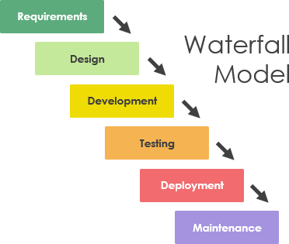
Waterfall Model
The waterfall model is a breakdown of project activities into linear sequential phases, where each phase depends on the on the previous one
Each phase is carried out completely (for all requirements) before proceeding to the next.
The process is strictly sequential - no backing up or repeating phases.
Advantages: -Simple, easy to understand and follow. -Highly structured, therefore good for beginners. -After specification is complete, low customer involvement required.
Disadvantages: Inflexible - can't adapt to changes in requirements.

Slide 40
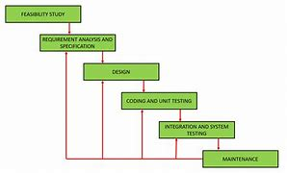
Iterative Waterfall Model It is almost the same as the classical waterfall model except some changes are made to increase the efficiency of the software development. The iterative waterfall model provides feedback paths from every phase to its preceding phases, which is the main difference from the classical waterfall model. Feedback paths introduced by the iterative waterfall model are shown in the figure below.

Slide 41
When errors are detected at some later phase, these feedback paths allow for correcting errors committed by programmers during some phase. The feedback paths allow the phase to be reworked in which errors are committed and these changes are reflected in the later phases. But, there is no feedback path to the stage – feasibility study, because once a project has been taken, does not give up the project easily.
It is good to detect errors in the same phase in which they are committed. It reduces the effort and time required to correct the errors.
The Iterative Waterfall Model is a software development approach that combines the sequential steps of the traditional Waterfall Model with the flexibility of iterative design. It allows for improvements and changes to be made at each stage of the development process, instead of waiting until the end of the project.
Advantages of Iterative Waterfall Model :
Feedback Path
Simple
Cost-Effective
Well-organized
Risk Reduction
Quality Assurance
Improved Customer Satisfaction
Predictable Outcomes
Faster Time to Market
hen errors are detected at some later phase, these feedback paths allow for correcting errors committed by programmers during some phase. The feedback paths allow the phase to be reworked in which errors are committed and these changes are reflected in the later phases. But, there is no feedback path to the stage – feasibility study, because once a project has been taken, does not give up the project easily.
It is good to detect errors in the same phase in which they are committed. It reduces the effort and time required to correct the errors.
The Iterative Waterfall Model is a software development approach that combines the sequential steps of the traditional Waterfall Model with the flexibility of iterative design. It allows for improvements and changes to be made at each stage of the development process, instead of waiting until the end of the project.

Slide 42
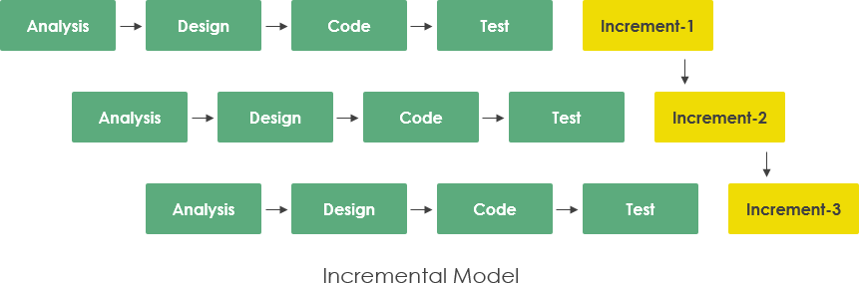
Incremental model
The incremental build model is a method of software development where the model is designed, implemented and tested incrementally until the product is finished. It involves both development and maintenance. The product is defined as finished when it satisfies all of its requirements. Each iteration passes through the requirements, design, coding and testing phases. And each subsequent release of the system adds function to the previous release until all designed functionally has been implemented. This model combines the elements of the waterfall model with the iterative philosophy of prototyping.

Slide 43
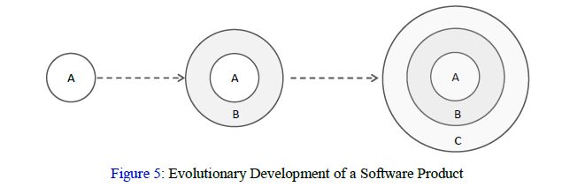
Evolutionary Process Models
Evolutionary models are iterative type models.
Evolutionary model is also referred to as the successive versions model and sometimes as the incremental model.
In Evolutionary model, the software requirement is first broken down into several modules (or functional units) that can be incrementally constructed and delivered
They allow to develop more complete versions of the software.
Following are the evolutionary process models. 1. The prototyping model 2. The spiral model

Slide 44
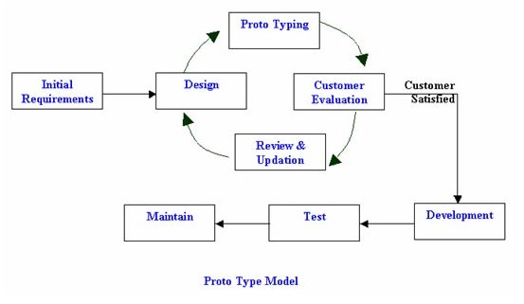
Prototype model: In the prototype model the initial requirements gathering is done. A quick design prototype is prepared. This prototype is developed based on the currently known requirements. By using this prototype, the client can get an overview of the system, since the interactions with prototype can enable the client to better understand the requirements of the desired system. The customer evaluates the prototype to refine the requirements.

Slide 45
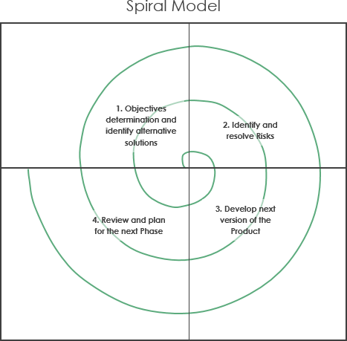
Spiral model: It is an evolutionary software process model combining the iterative nature of prototyping with the controlled and systematic aspects of a linear sequential model. It provides the potential for rapid development of incremental versions of the software. - The spiral model is intended for large, expensive and complicated projects. - The spiral model focuses on identifying and eliminating high-risk problems by careful process design.
-The spiral model goes through the planning, design, build and test phases over and over, with gradual improvements at each pass.

Slide 46
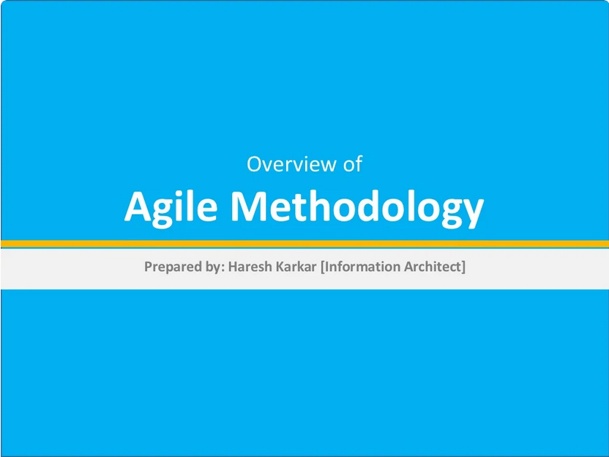

Slide 47
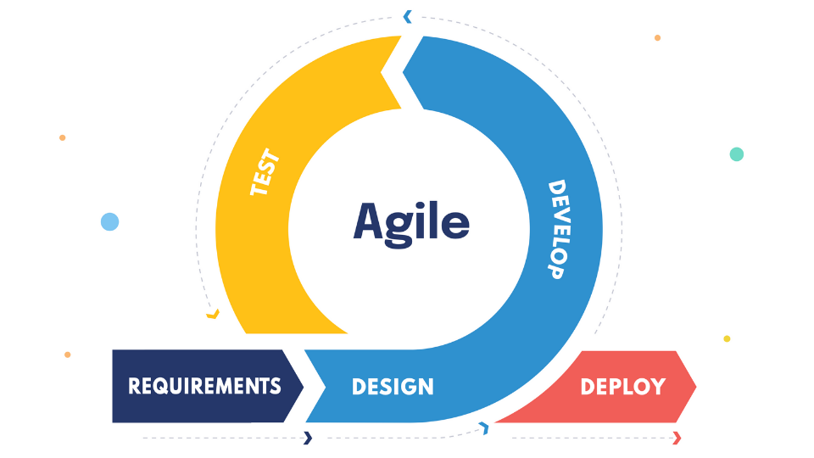

Slide 48
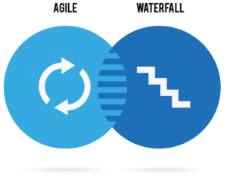
Agile Vs Waterfall?

Slide 49
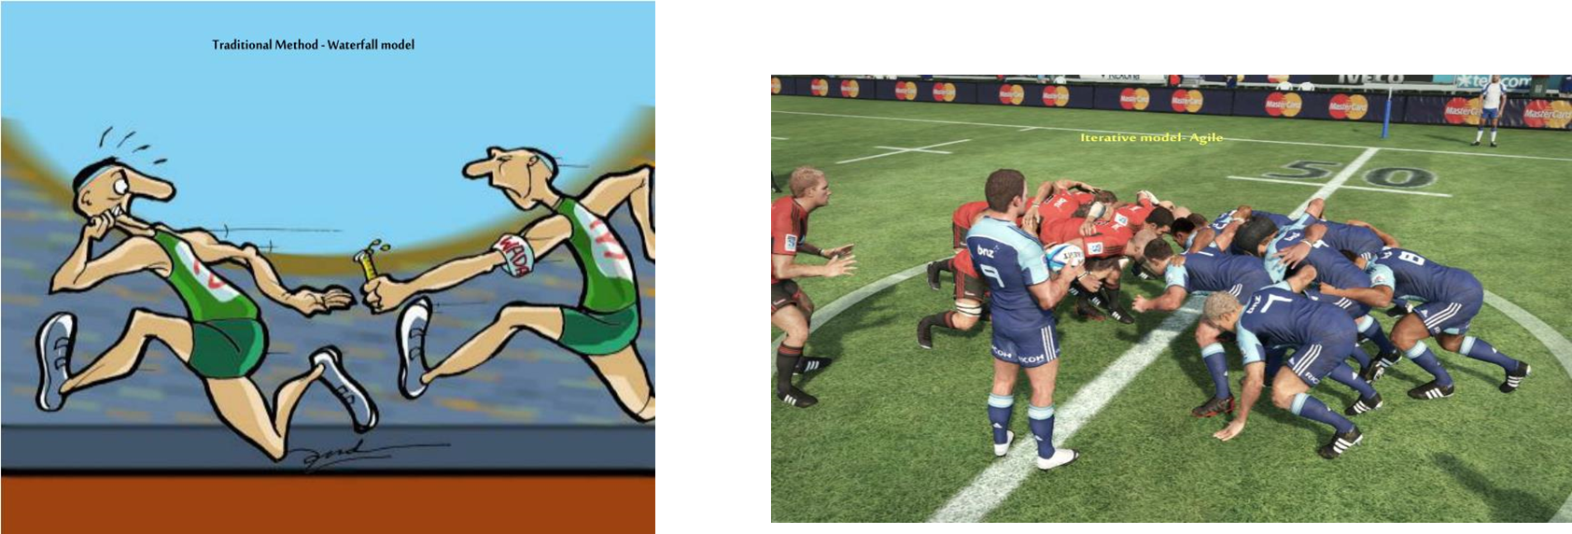
WATERFALL
AGILE

Slide 50
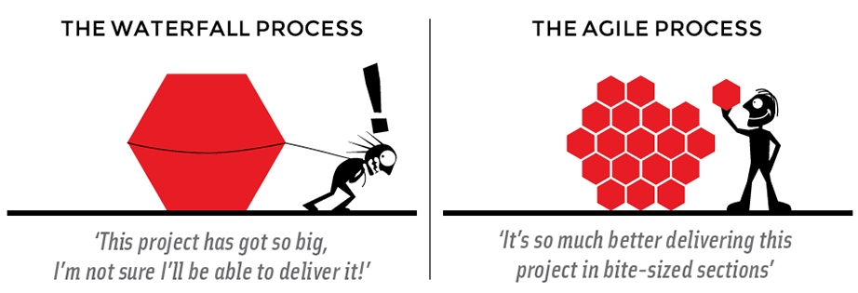

Slide 51
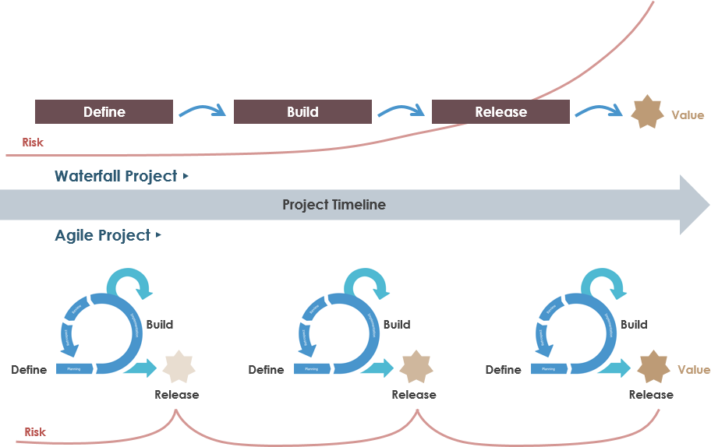

Slide 52
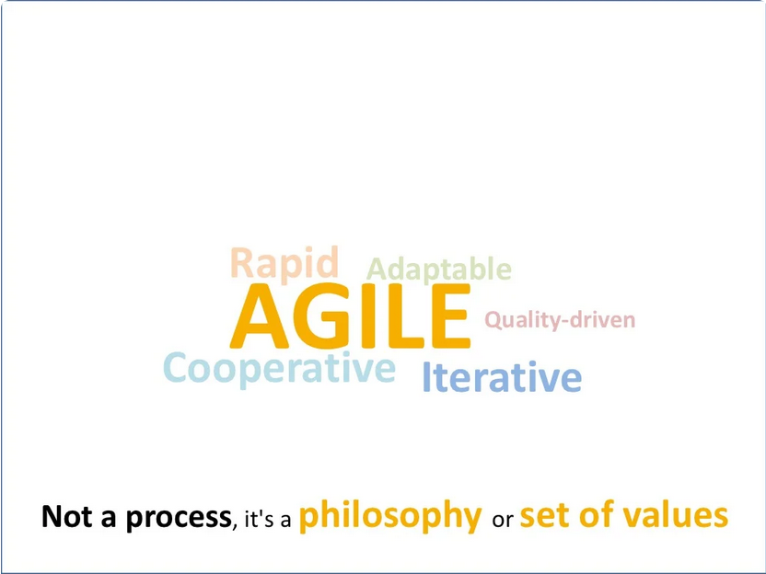
Agile focuses on keeping the process lean and creating minimum viable products (MVPs) that go through several iterations before anything is final.
Feedback is gathered and implemented continually and in all, it is a much more dynamic process where everyone is working together towards one goal.
Agile is all about short cycles, iterative and incremental delivery, failing fast, getting feedback, delivering business value to customers early and about people, collaboration and interaction.
Agile is a mindset that is all about transparency, inspection, and adaptation.

Slide 53
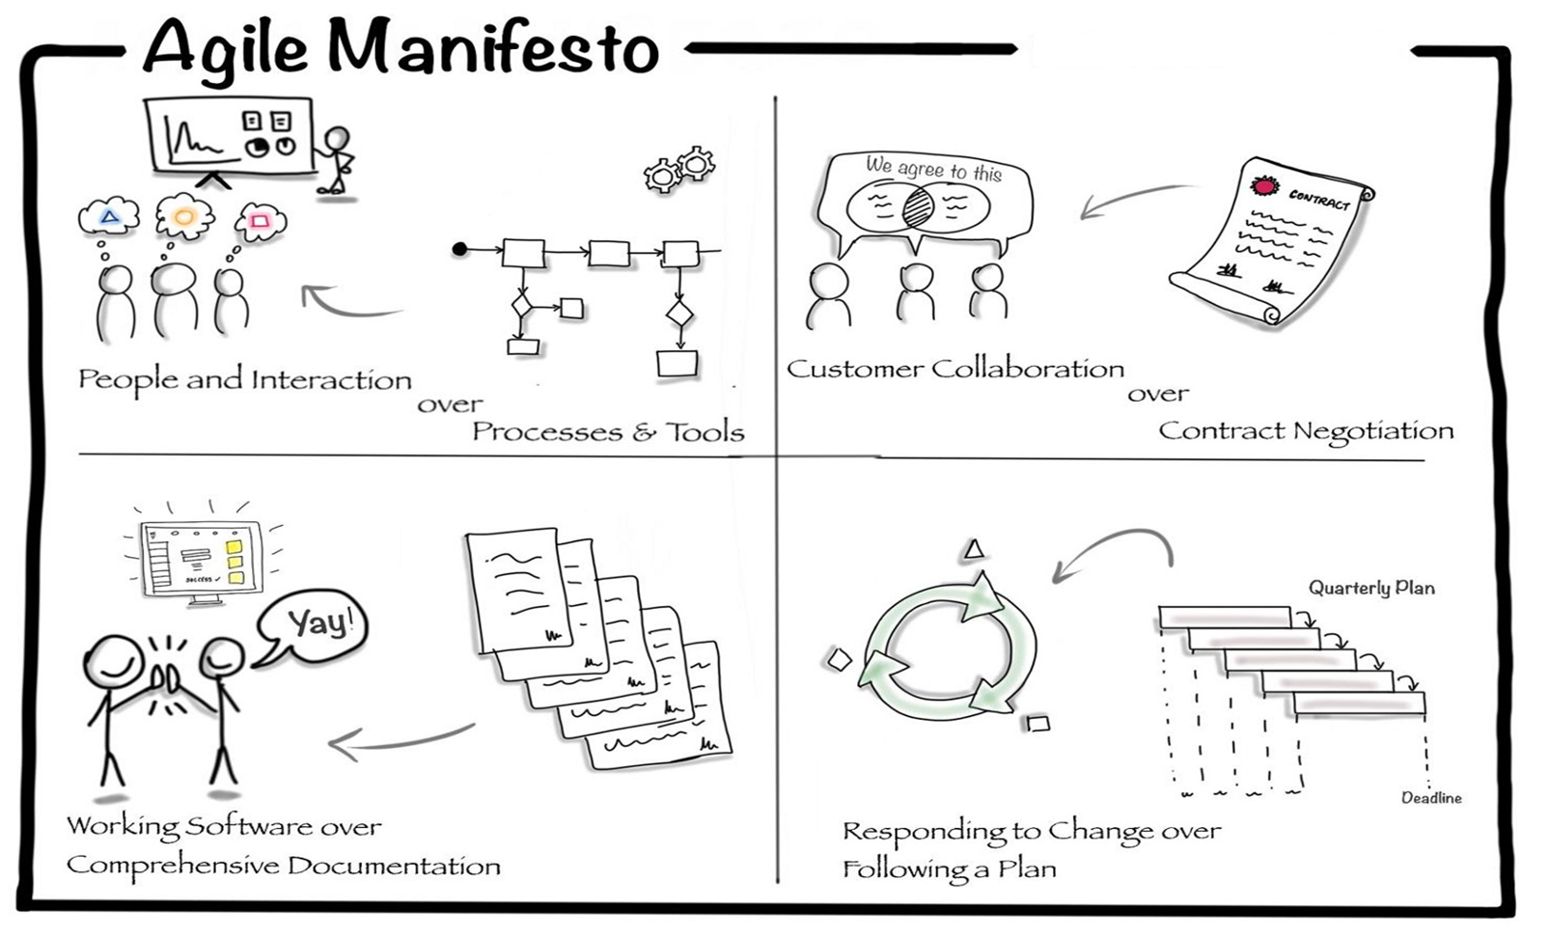

Slide 54
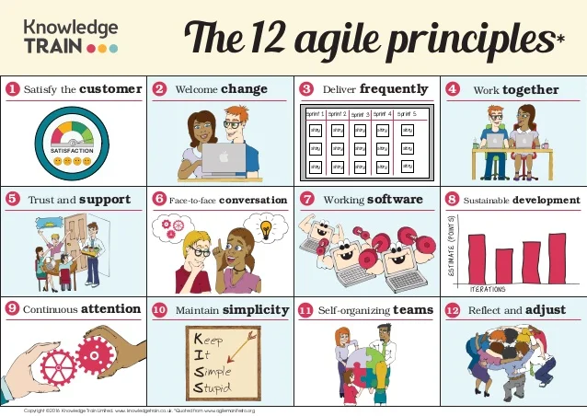

Slide 55
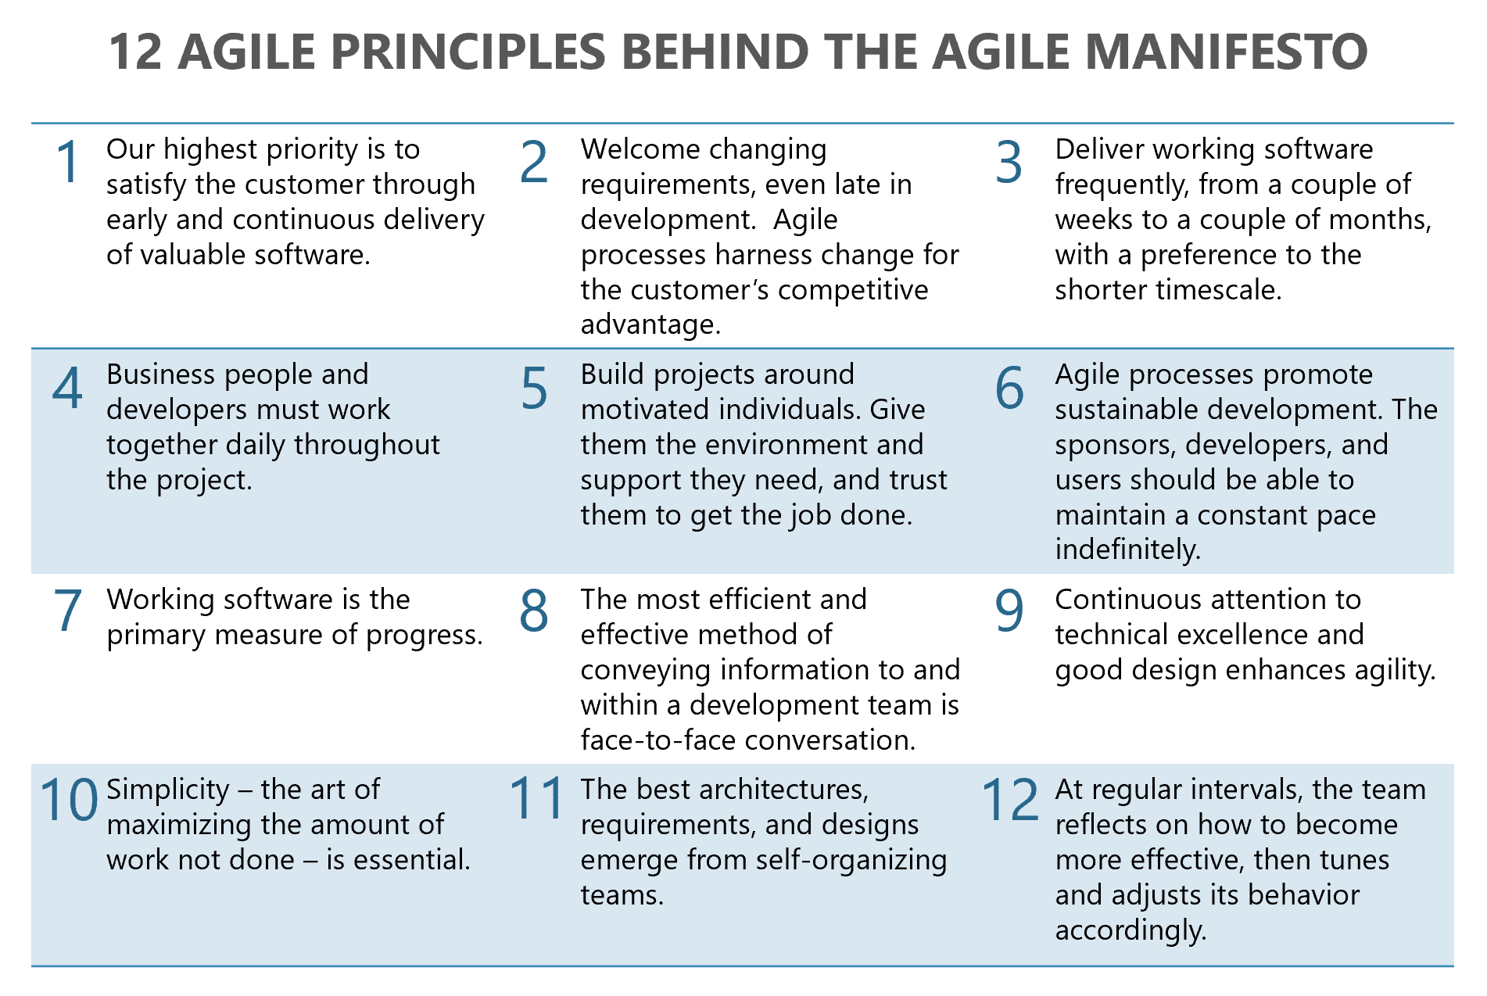

Slide 56
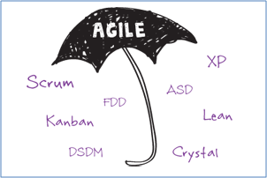
Leading Agile Methods
Scrum
Kanban
Extreme Programming (XP)
Feature-Driven Development (FDD)
Dynamic Systems Development Method (DSDM)
Adaptive Software Development (ASD)
Rapid Application Development (RAD)
Crystal
Scaled Agile Framework (SAFe)

Slide 57
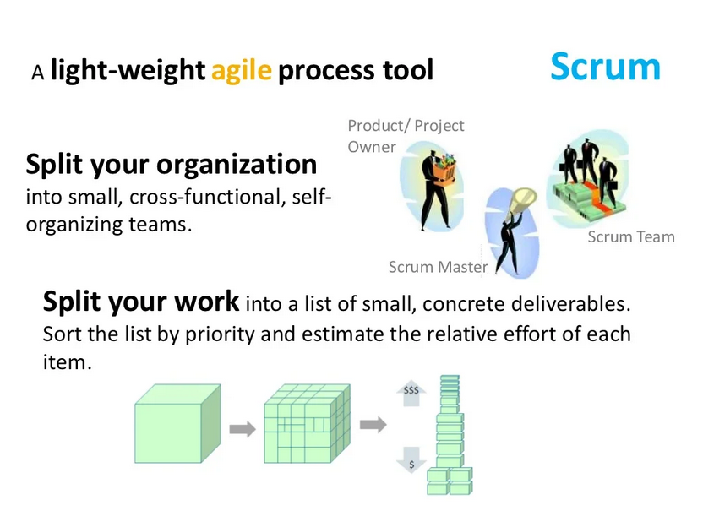

Slide 58
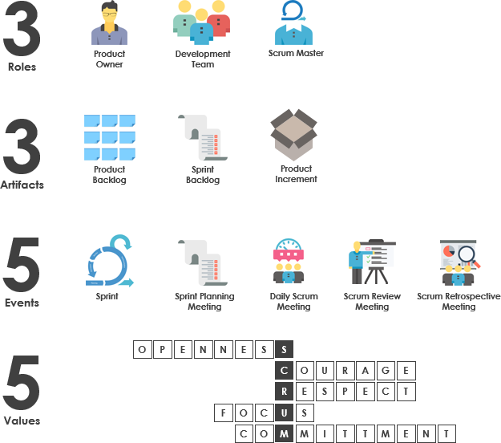
Scrum Framework Basics
Scrum is a framework within which people can address complex adaptive problems, while productively and creatively delivering products of the highest possible value.

Slide 59
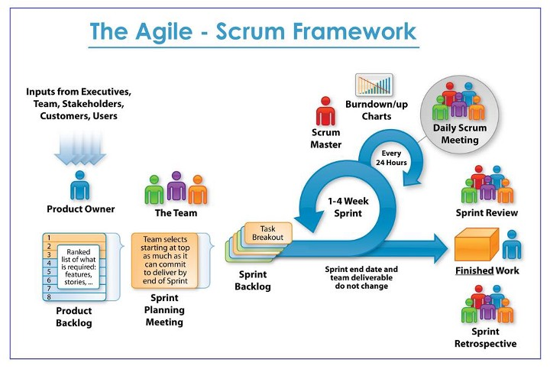

Slide 60
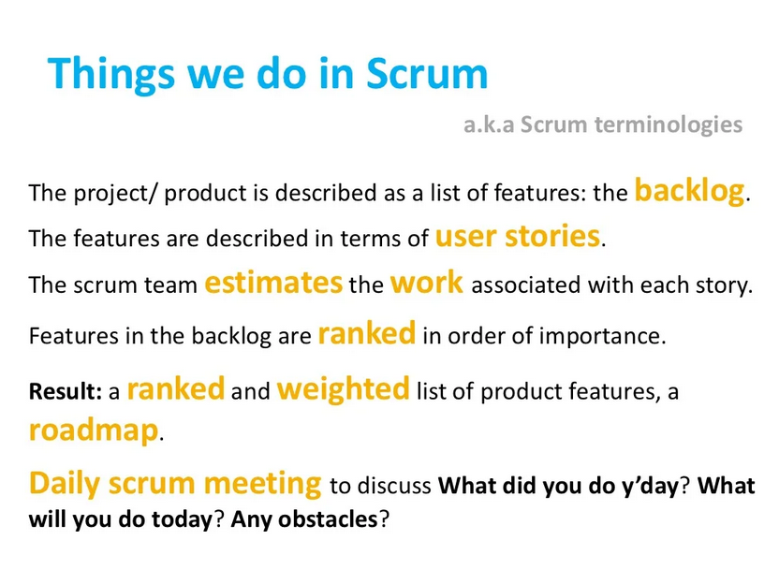

Slide 61
Example

Slide 64
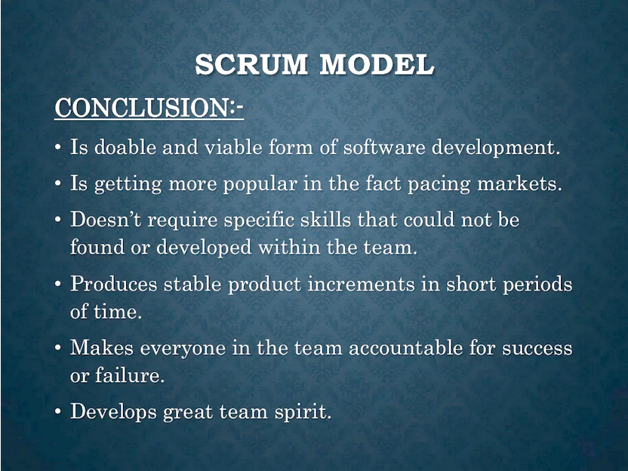

Slide 65
Extreme Programming
Extreme Programming is one of the Agile software development methodologies.
XP is a lightweight, efficient, low-risk, flexible, predictable, scientific, and fun way to develop a software.
Small to medium sized teams that work under vague and rapidly changing requirements.
It provides values and principles to guide the team behaviour. The team is expected to self-organize.
Follows Object Oriented Approach.

Slide 66
Values of extreme programming:
XP has simple rules that are based on 5 values to guide the teamwork:
Communication. Everyone on a team works jointly at every stage of the project.
Simplicity. Developers strive to write simple code bringing more value to a product, as it saves time and effort.
Feedback. Team members deliver software frequently, get feedback about it, and improve a product according to the new requirements.
Respect. Every person assigned to a project contributes to a common goal.
Courage. Programmers objectively evaluate their own results without making excuses and are always ready to respond to changes.

Slide 67
Principles of extreme programming
Most researchers denote 5 XP principles as:
Rapid feedback. Team members understand the given feedback and react to it right away.
Assumed simplicity. Developers need to focus on the job that is important at the moment.
Incremental changes. Small changes made to a product step by step work better than big ones made at once.
Embracing change. If a client thinks a product needs to be changed, programmers should support this decision and plan how to implement new requirements.
Quality work. A team that works well, makes a valuable product and feels proud of it.

Slide 68
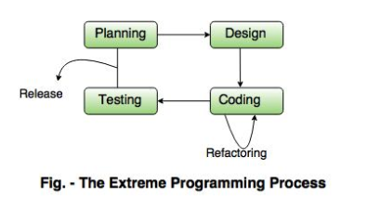

Slide 69
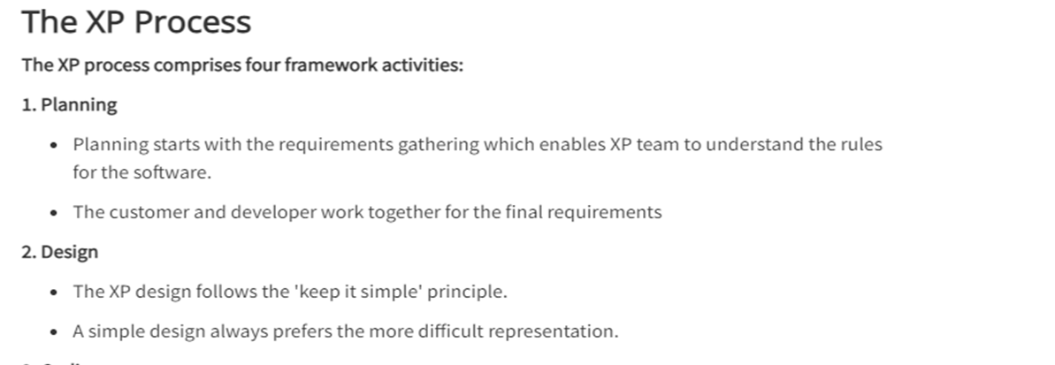

Slide 70
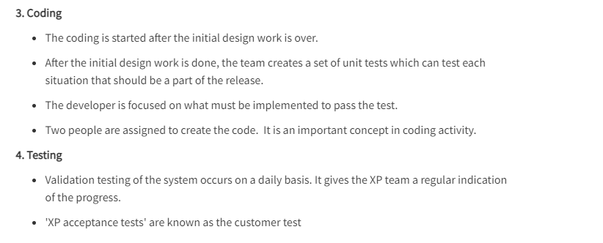

Slide 71
Why is it called “Extreme?”
Extreme Programming takes the effective principles and practices to extreme levels.
Code reviews are effective as the code is reviewed all the time.
Testing is effective as there is continuous regression and testing.
Design is effective as everybody needs to do refactoring daily.
Integration testing is important as integrate and test several times a day.
Short iterations are effective as the planning game for release planning and iteration planning.

Slide 72
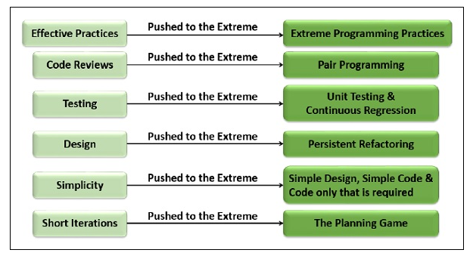

Slide 73
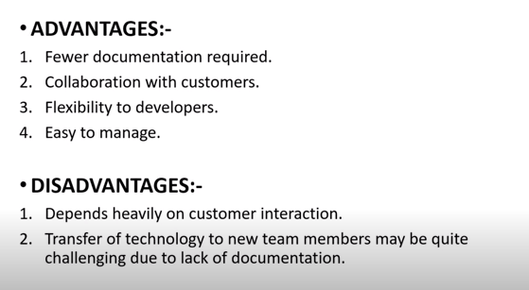

Slide 74


